Slide 1
Querying Data by Using Athena
Made for Professor Lanham A. by Amrit Singh

Slide 2
AGENDA
Accessing the AWS management console
Task 1: Creating and querying an AWS Glue database and table in Athena
Task 2: Optimizing Athena queries by using buckets
Task 3: Optimizing Athena queries by using partitions
Task 4: Using Athena views
Task 5: Creating a Lambda function to send notifications
Task 6: Reviewing the IAM policy for Athena and AWS Glue access
Task 7: Confirming that Mary can access and use the named query

Slide 3
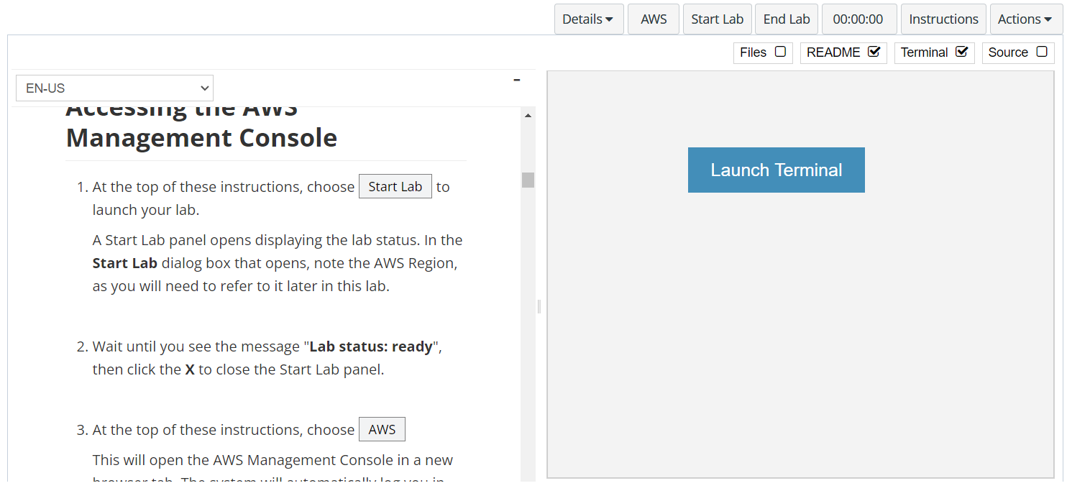
In aws labs click on start lab

Slide 4
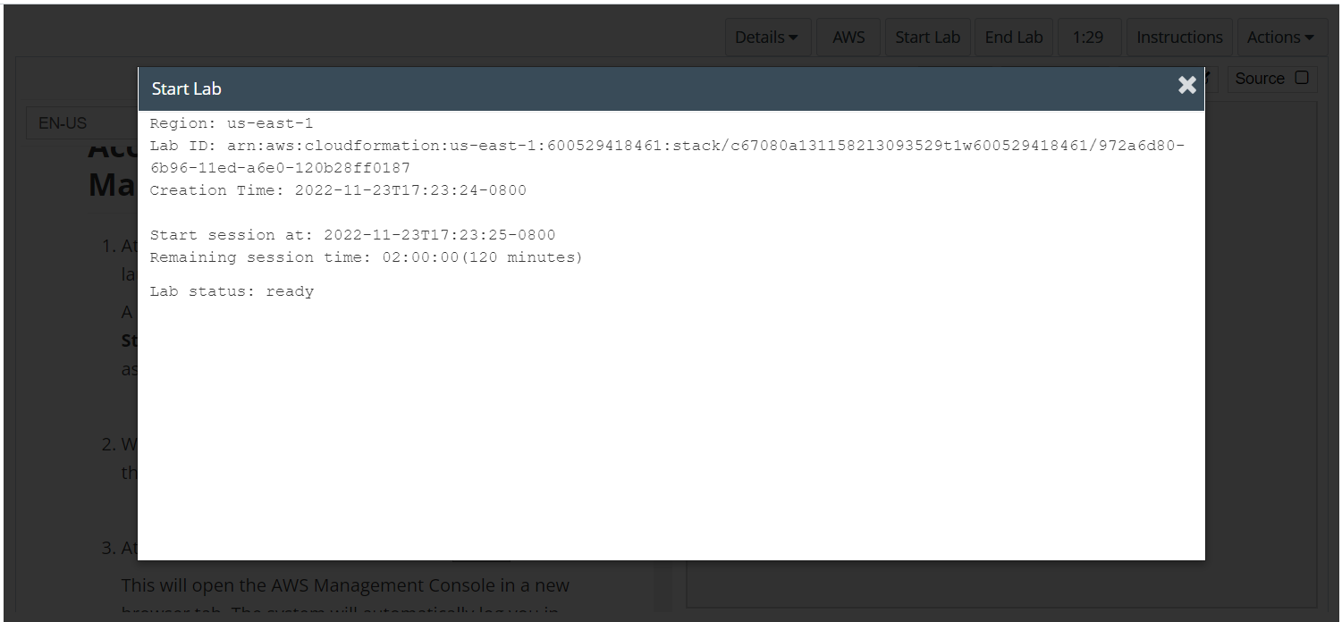
Wait to see lab ready status in the window then press x and click on aws to launch console

Slide 5
Task 1: Creating and querying an AWS Glue database and table in Athena

Slide 6
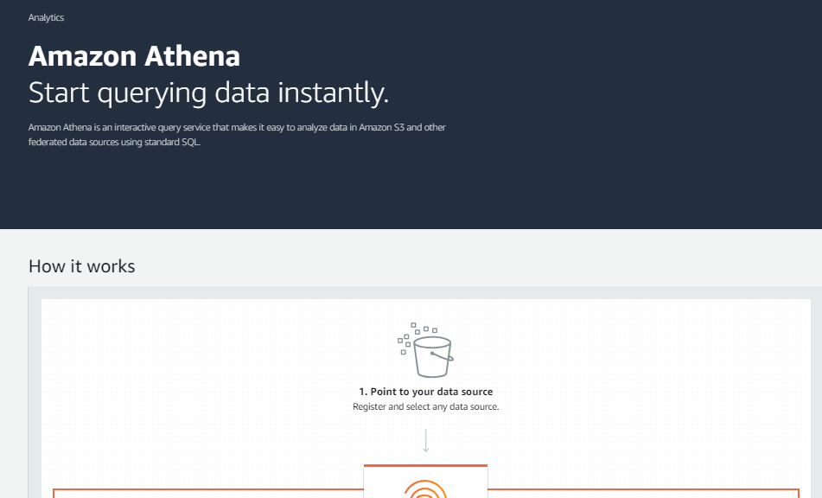
OPEN THE Athena CONSOLE
In the AWS Management Console, on the Services menu, choose Athena.

Slide 7
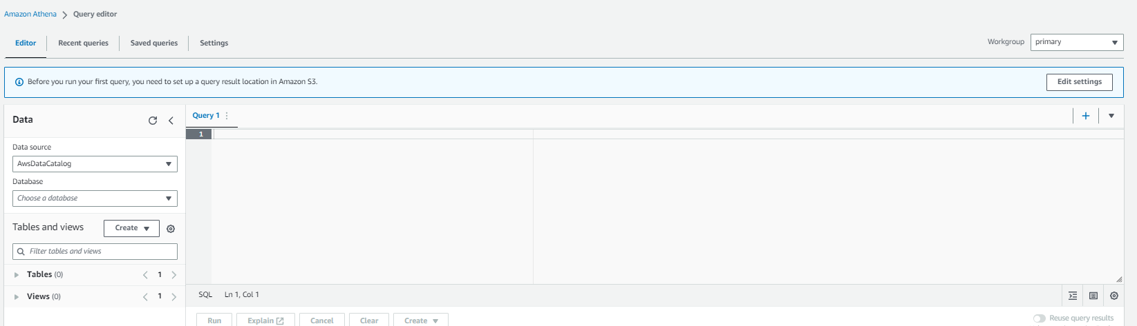
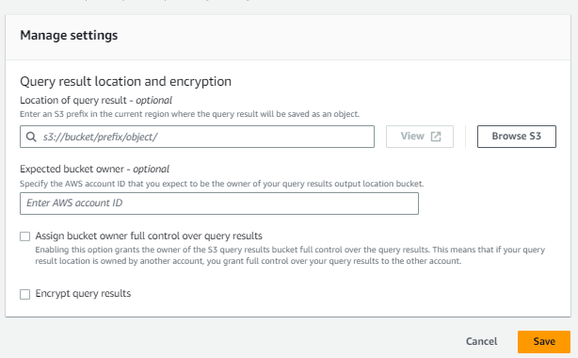
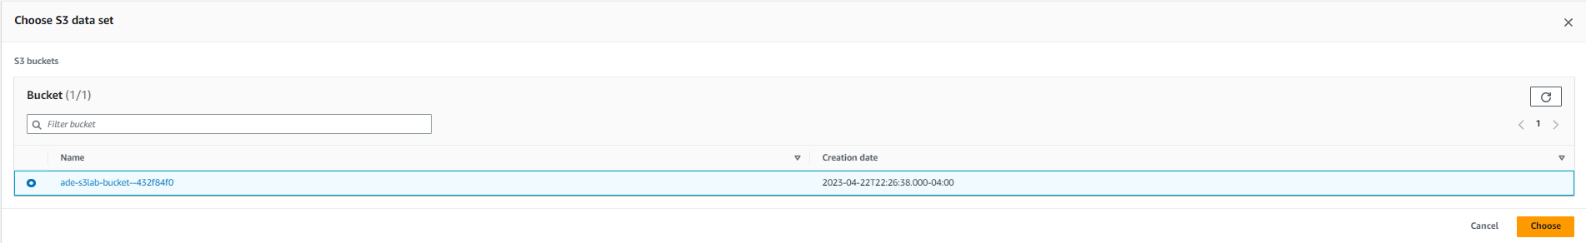
Set the aws s3 bucket for analysis in athena
Specify an S3 bucket for query results.
When you use Athena, you must first specify an S3 bucket to hold the results for any queries that you run. A bucket was created for you. Complete the following steps to configure and use it.
In the Athena console, choose Explore the query editor.
Choose the Settings tab.
In the Query result and encryption settings section, choose Manage.
For Location of query result, choose Browse S3.
Choose the bucket that was created for you, and then select choose.
Keep the defaults for the other settings on the page, and choose Save

Slide 8
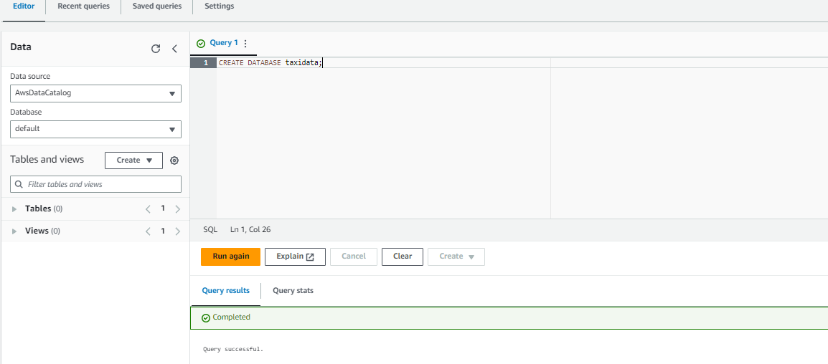
Create the database in athena
Create an AWS Glue database by using the Athena query editor.
Choose the Editor tab.
In the Query 1 section, enter the following SQL command: CREATE DATABASE taxidata;
Choose Run.
The message Query successful displays, and an AWS Glue database named taxidata is created

Slide 9
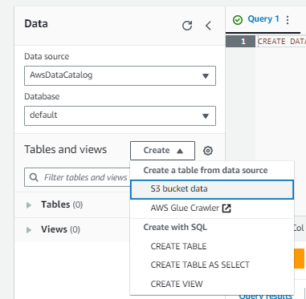
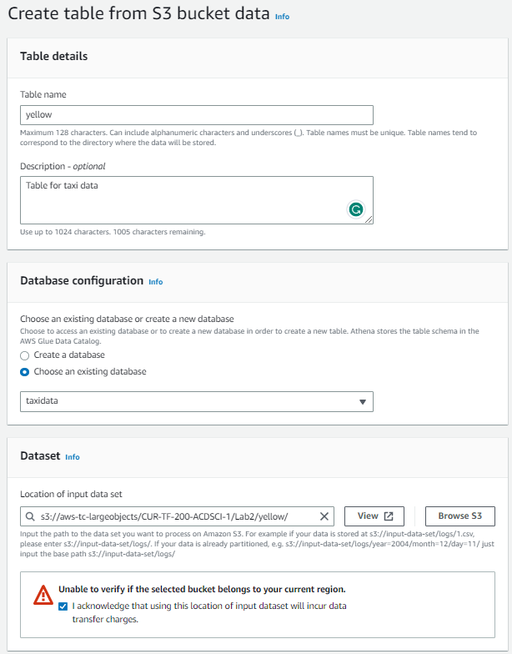
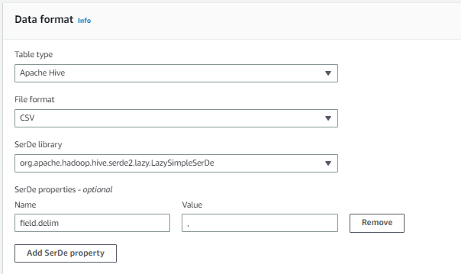
Configure the tables and views in the database
In the Athena console, in the Tables and views section on the left, choose Create > S3 bucket data, and configure the following:
Table name: Enter yellow
Description: Enter Table for taxi data
Database configuration: Select Choose an existing database, and then choose taxidata from the dropdown list.
Location of input dataset: Copy the following link into the field: s3://aws-tc-largeobjects/CUR-TF-200-ACDSCI-1/Lab2/yellow/
Encryption: Keep the default setting, which is not selected.
Data format: Choose CSV.
In the Column details section, choose Bulk add columns.

Slide 10
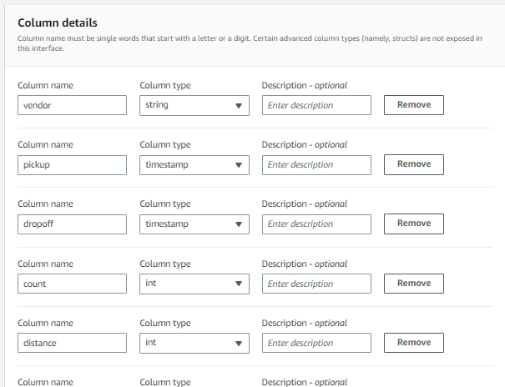
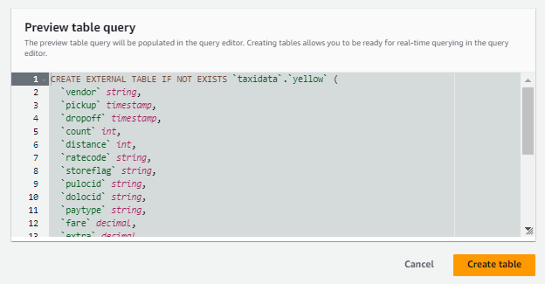
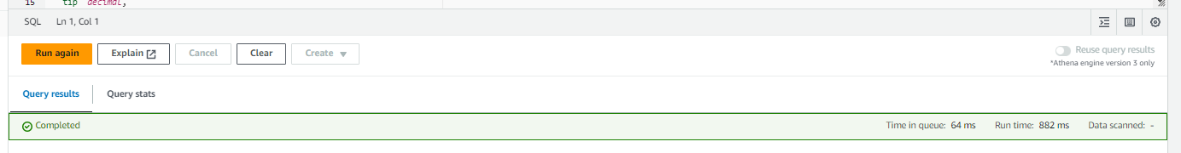
Configure the tables and views in the database continued
In the Column details section, choose Bulk add columns
In the pop-up box, copy and paste the following text, and then choose Add:
In the Preview table query section, view the preview table query text, which matches the following text:
Choose Create table.
vendor string,
pickup timestamp,dropoff timestamp,count int,distance int,ratecode string,storeflag string,pulocid string,dolocid string,paytype string,fare decimal,extra decimal,mta_tax decimal,tip decimal,tolls decimal,surcharge decimal,total decimal
CREATE EXTERNAL TABLE IF NOT EXISTS taxidata.yellow (
`vendor` string, `pickup` timestamp, `dropoff` timestamp, `count` int, `distance` int, `ratecode` string, `storeflag` string, `pulocid` string, `dolocid` string, `paytype` string, `fare` decimal, `extra` decimal, `mta_tax` decimal, `tip` decimal, `tolls` decimal, `surcharge` decimal, `total` decimal ) ROW FORMAT SERDE 'org.apache.hadoop.hive.serde2.lazy.LazySimpleSerDe' WITH SERDEPROPERTIES ( 'serialization.format' = ',', 'field.delim' = ',' ) LOCATION 's3://aws-tc-largeobjects/CUR-TF-200-ACDSCI-1/Lab2/yellow/' TBLPROPERTIES ('has_encrypted_data'='false');

Slide 11
Configure the tables and views in the database continued
In the Column details section, choose Bulk add columns
In the pop-up box, copy and paste the following text, and then choose Add:
In the Preview table query section, view the preview table query text, which matches the following text:
Choose Create table.
vendor string,
pickup timestamp,dropoff timestamp,count int,distance int,ratecode string,storeflag string,pulocid string,dolocid string,paytype string,fare decimal,extra decimal,mta_tax decimal,tip decimal,tolls decimal,surcharge decimal,total decimal
CREATE EXTERNAL TABLE IF NOT EXISTS taxidata.yellow (
`vendor` string, `pickup` timestamp, `dropoff` timestamp, `count` int, `distance` int, `ratecode` string, `storeflag` string, `pulocid` string, `dolocid` string, `paytype` string, `fare` decimal, `extra` decimal, `mta_tax` decimal, `tip` decimal, `tolls` decimal, `surcharge` decimal, `total` decimal ) ROW FORMAT SERDE 'org.apache.hadoop.hive.serde2.lazy.LazySimpleSerDe' WITH SERDEPROPERTIES ( 'serialization.format' = ',', 'field.delim' = ',' ) LOCATION 's3://aws-tc-largeobjects/CUR-TF-200-ACDSCI-1/Lab2/yellow/' TBLPROPERTIES ('has_encrypted_data'='false');

Slide 12
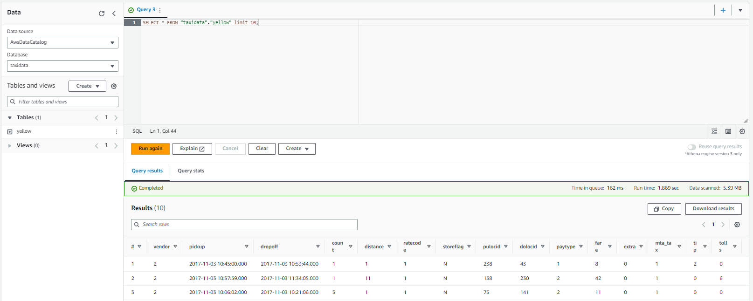
Preview the data in glue table
Preview data in the AWS Glue table.
In the Data section on the left, for Database, choose taxidata.
In the Tables section, to the right of the yellow table, choose the ellipsis (three dot) icon, and then choose Preview Table.
The Results section displays the first 10 records of the table.
Before continuing, at the top of the query editor, close the open queries by choosing the X icon on each query tab. When prompted, choose Close query.

Slide 13
Task 2: Optimizing Athena queries by using buckets

Slide 14
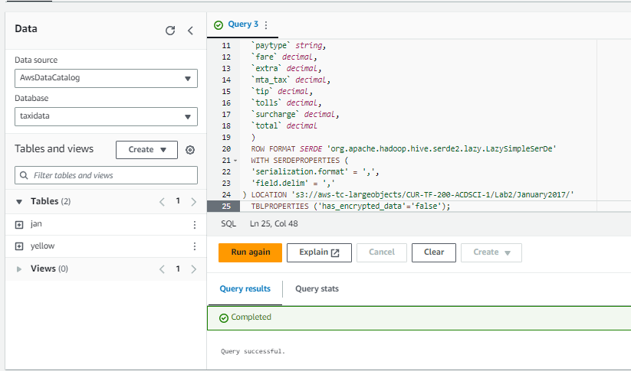
RUN THE FOLLOWING QUERY IN ATHENA
Create a table for the January 2017 data.
In the Athena query editor, choose the Editor tab.
To open a new query tab, choose the plus icon on the right side of the query section.
Copy and paste the following text into the new query tab, and then choose Run:
CREATE EXTERNAL TABLE IF NOT EXISTS jan (
`vendor` string, `pickup` timestamp, `dropoff` timestamp, `count` int, `distance` int, `ratecode` string, `storeflag` string, `pulocid` string, `dolocid` string, `paytype` string, `fare` decimal, `extra` decimal, `mta_tax` decimal, `tip` decimal, `tolls` decimal, `surcharge` decimal, `total` decimal ) ROW FORMAT SERDE 'org.apache.hadoop.hive.serde2.lazy.LazySimpleSerDe' WITH SERDEPROPERTIES ( 'serialization.format' = ',', 'field.delim' = ',') LOCATION 's3://aws-tc-largeobjects/CUR-TF-200-ACDSCI-1/Lab2/January2017/' TBLPROPERTIES ('has_encrypted_data'='false');

Slide 15
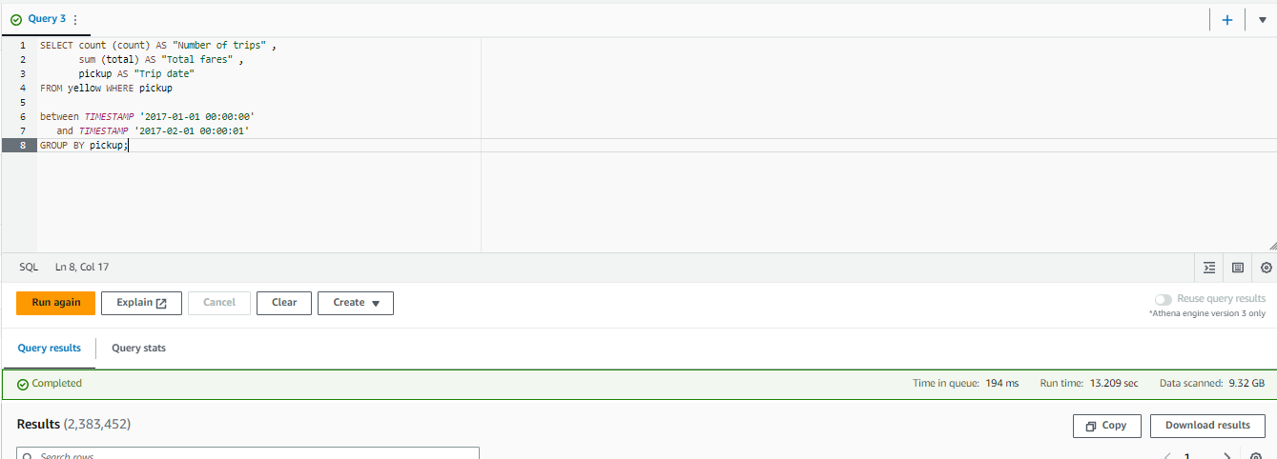
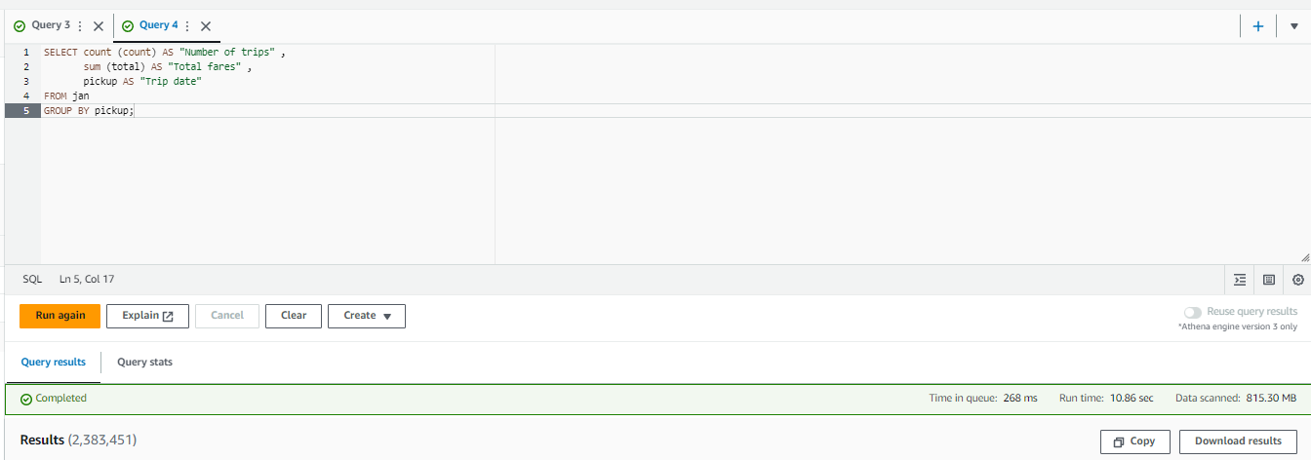
QUERYING DATA FROM YELLOW TABLE
Run the following query on the yellow table, which has data for the entire year. The data is not divided into monthly buckets.
The message Query successful displays. Note the run time and amount of data scanned for the query.
Now, you will compare that by running a query against the jan table.
Run the following query on the jan table.
Note the run time and amount of data scanned for the query. As you can see, much less data is scanned when the query is performed against the table that only contains the January data
sELECT count (count) AS "Number of trips" ,
sum (total) AS "Total fares" , pickup AS "Trip date"FROM yellow WHERE pickup between TIMESTAMP '2017-01-01 00:00:00' and TIMESTAMP '2017-02-01 00:00:01'GROUP BY pickup;
SELECT count (count) AS "Number of trips" ,
sum (total) AS "Total fares" , pickup AS "Trip date"FROM janGROUP BY pickup;

Slide 16
Task 3: Optimizing Athena queries by using partitions

Slide 17
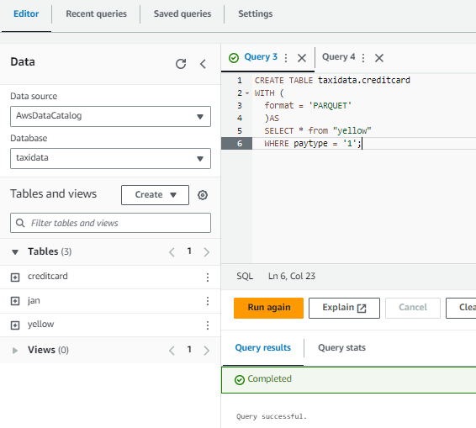
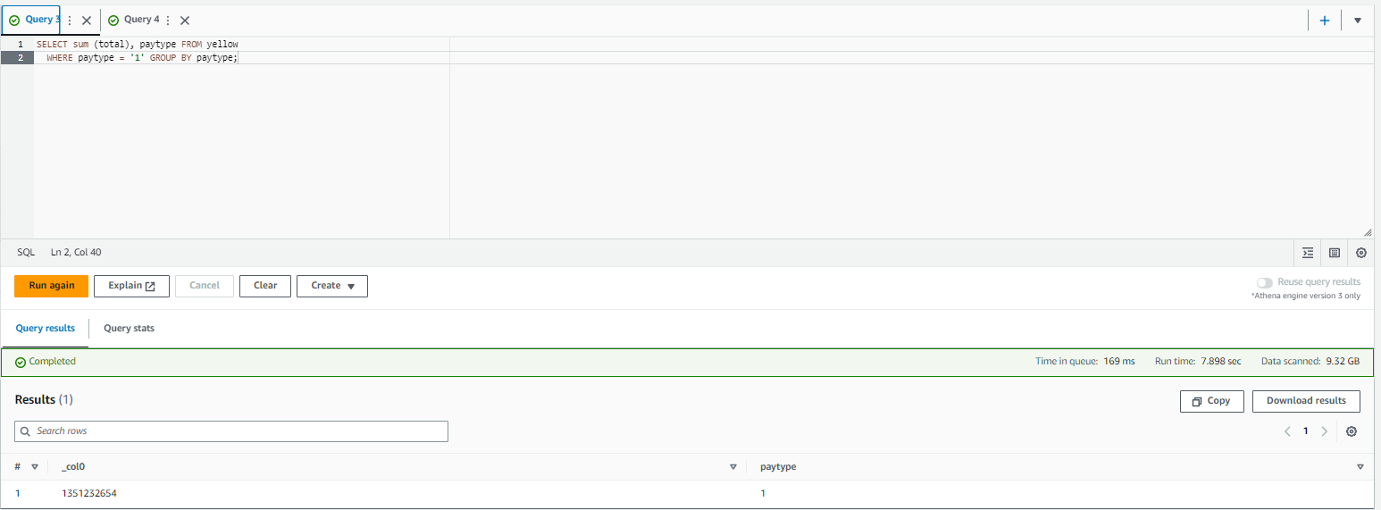
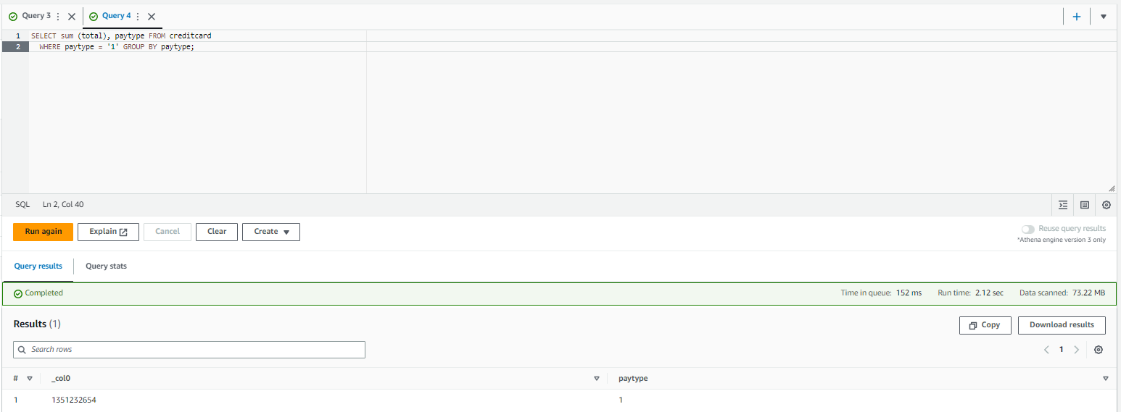
Creating partition in tables
To create a new table called taxidata.creditcard that is partitioned for paytype = 1 (credit card transactions), run the following query in a new query tab:
The run time and data scanned values are similar to the following:
To query the nonpartitioned data in the yellow table, run the following query in a new query tab:
The run time and data scanned values are similar to the following:
To query the partitioned data in the creditcard table, run the following query in a new query tab:
The run time and data scanned values are similar to the following:
CREATE TABLE taxidata.creditcard
WITH ( format = 'PARQUET' )AS SELECT * from "yellow" WHERE paytype = '1';
Time in queue: 251 ms
Run time: 28.572 secData scanned: 9.32 GB
SELECT sum (total), paytype FROM yellow
WHERE paytype = '1' GROUP BY paytype;
Time in queue: 215 ms
Run time: 8.081 secData scanned: 9.32 GB
SELECT sum (total), paytype FROM creditcard
WHERE paytype = '1' GROUP BY paytype;
Time in queue: 204 ms
Run time: 2.259 secData scanned: 73.22 MB

Slide 18
Task 4: Using Athena views

Slide 19
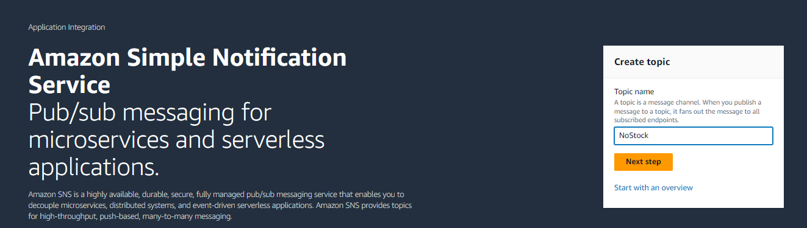
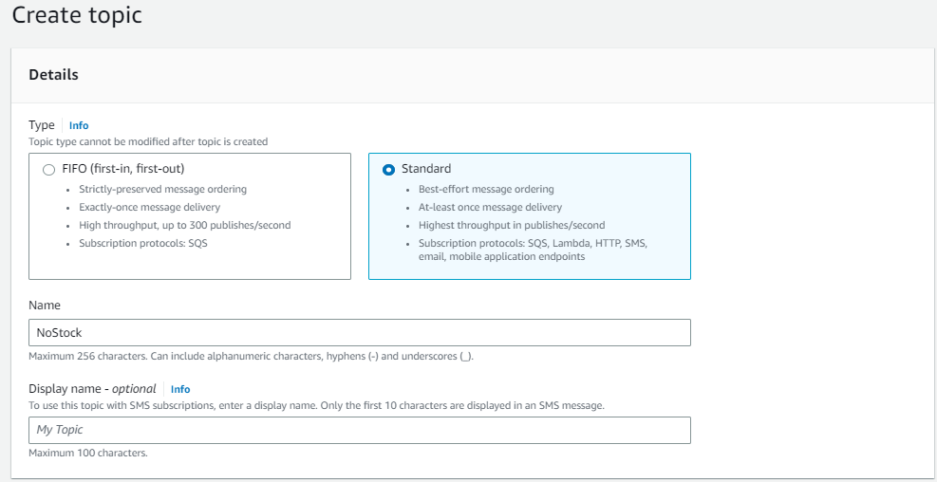
Open the sns console and create a new topic
n the Services menu, choose Simple Notification Service.
In the Create topic box, for Topic name, enter: NoStock. Keep Standard selected.
Choose Create topic

Slide 20
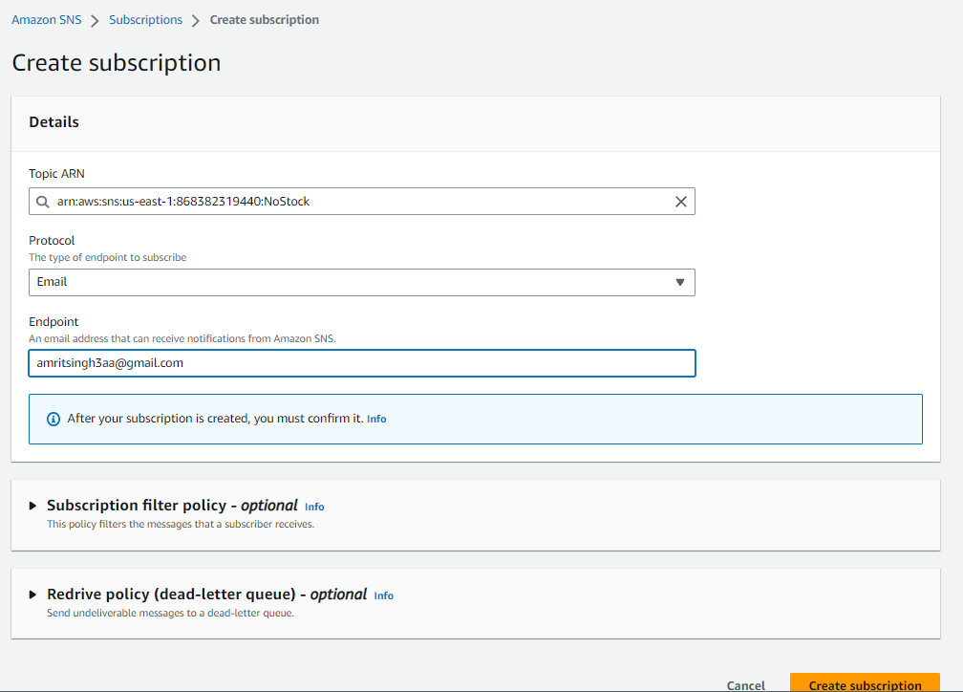
Chang ethe subscription settings and configure the following settings
In the lower half of the page, choose Create subscription and configure these settings:
Protocol: Email
Endpoint: Enter your email address
Choose Create subscription
After you create an email subscription, you will receive a confirmation email message. Open the message and choose the Confirm subscription link

Slide 21
Task 5: Creating a Lambda function to send notifications

Slide 22
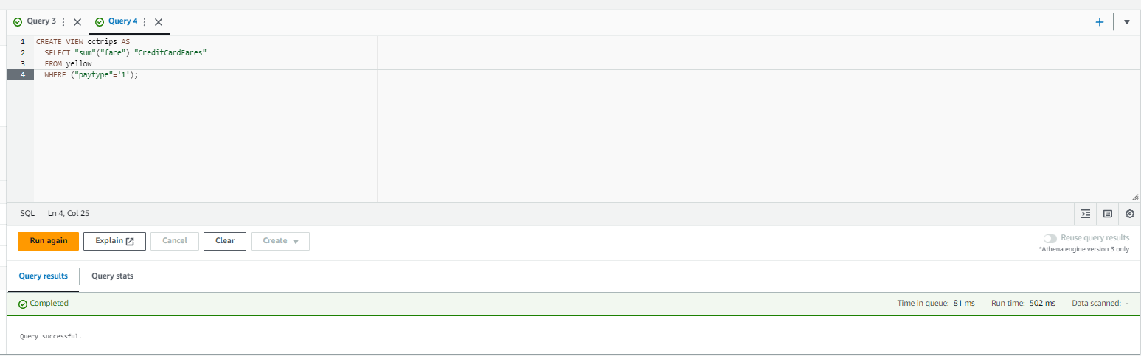
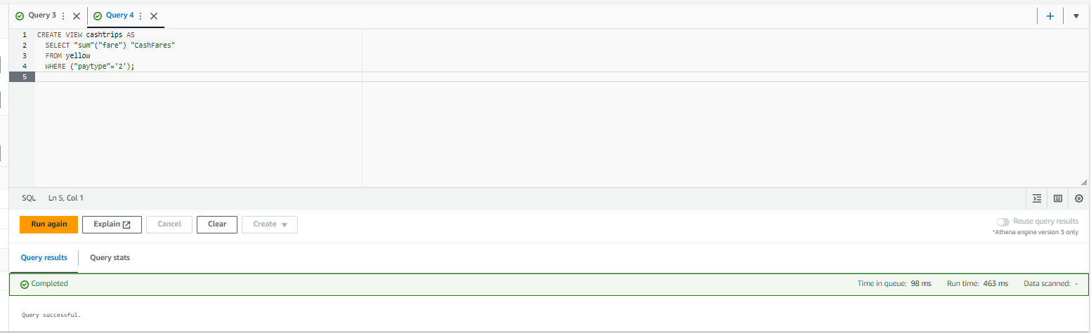
Create the following views
To create a view for the total dollar value of fares that were paid with a credit card, run the following query:
The run time and data scanned values are similar to the following:
To create a view for the total dollar value of fares that were paid with cash, run the following query:
The run time and data scanned values are similar to the following:
CREATE VIEW cctrips AS
SELECT "sum"("fare") "CreditCardFares" FROM yellow WHERE ("paytype"='1');
Time in queue: 55 ms
Run time: 408 msData scanned: -
CREATE VIEW cashtrips AS
SELECT "sum"("fare") "CashFares" FROM yellow WHERE ("paytype"='2');
Time in queue: 68 ms
Run time: 378 msData scanned: -

Slide 23
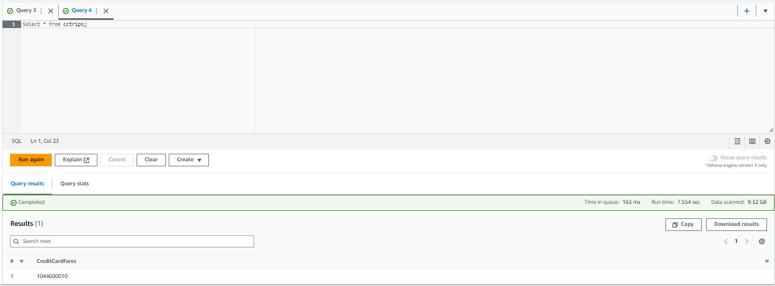
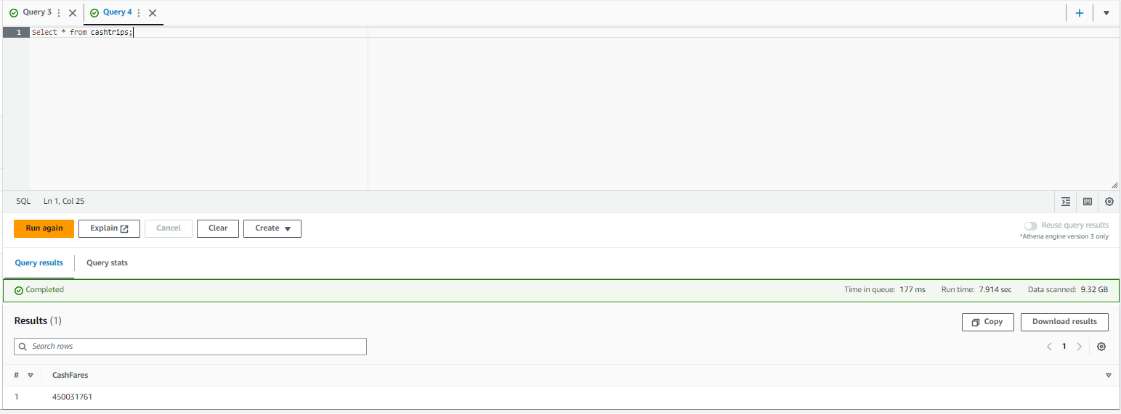
Select the records from the views
To select all records from the cctrips view, run the following query:
The run time and data scanned values are similar to the following:
To select all records from the cashtrips view, run the following query:
The run time and data scanned values are similar to the following:
Select * from cctrips;
Time in queue: 158 ms
Run time: 9.071 secData scanned: 9.32 GB
Select * from cashtrips;
Time in queue: 212 ms
Run time: 5.157 secData scanned: 9.32 GB

Slide 24
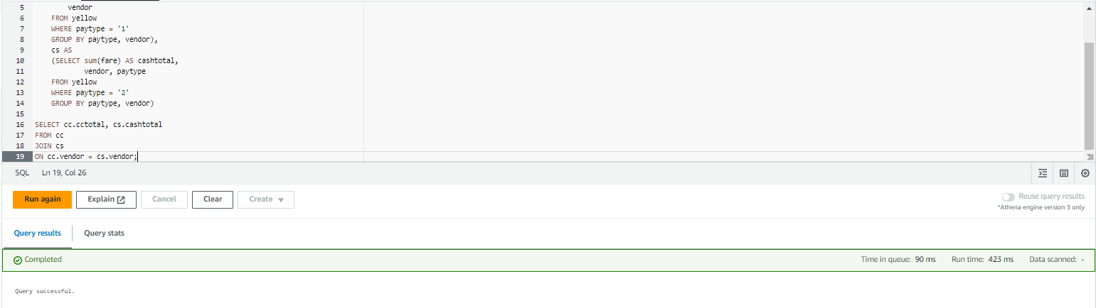
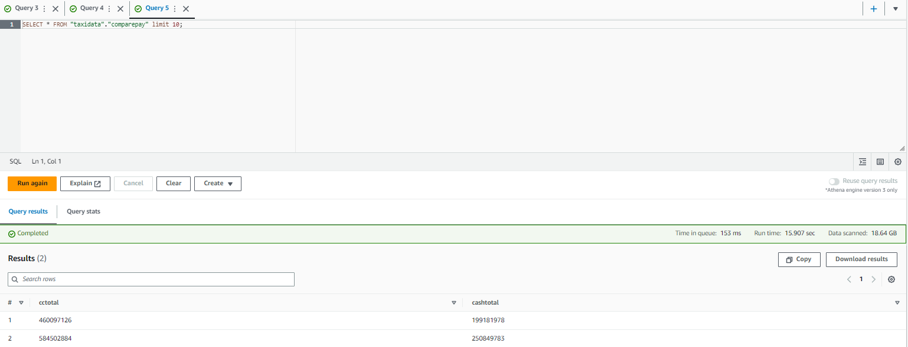
Create new view
To create a new view that joins the data, run the following query:
Preview the results from the join.
In the Views section on the left, to the right of the comparepay view, choose the ellipsis icon, and then choose Preview View.
If prompted about opening the query, choose Open query
CREATE VIEW comparepay AS
WITH cc AS (SELECT sum(fare) AS cctotal, vendor FROM yellow WHERE paytype = '1' GROUP BY paytype, vendor), cs AS (SELECT sum(fare) AS cashtotal, vendor, paytype FROM yellow WHERE paytype = '2' GROUP BY paytype, vendor) SELECT cc.cctotal, cs.cashtotalFROM ccJOIN csON cc.vendor = cs.vendor;

Slide 25
Task 5: Creating Athena named queries by using CloudFormation

Slide 26
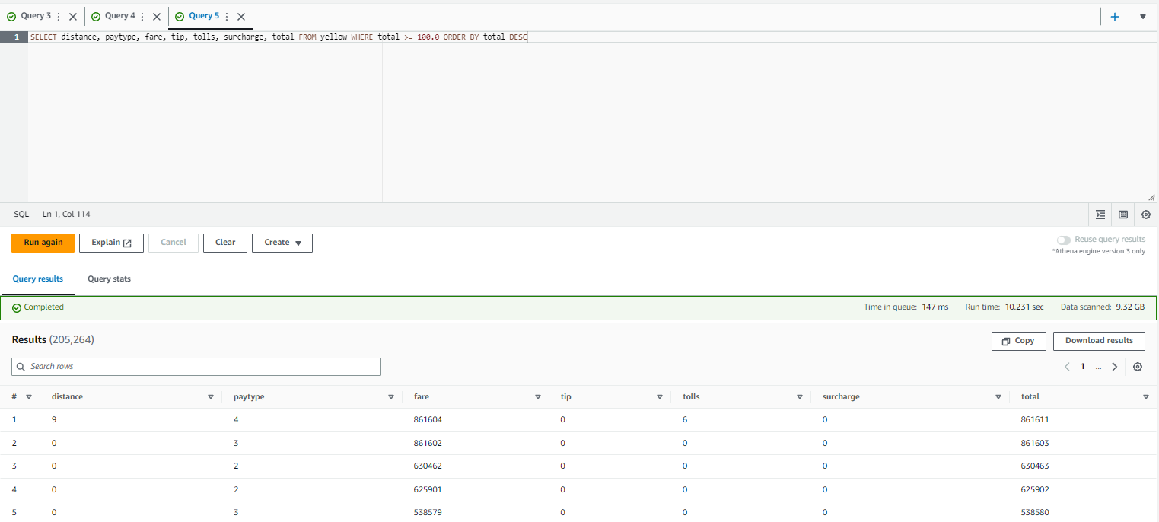
Run the query for the following output
Review and run the example query.
Mary provides you with the following example query:
This query uses the yellow table of the taxidata database. The query does the following actions:
Selects all records in the yellow table where the total charge is greater than or equal to $100.00
Displays the records in descending order by the total field (so the most expensive trip is displayed first in the results)
Displays the following fields for the resulting records:
Distance, paytype, fare, tip, tolls, surcharge, total
Run this example query in the Athena query editor.
SELECT distance, paytype, fare, tip, tolls, surcharge, total FROM yellow WHERE total >= 100.0 ORDER BY total DESC

Slide 27
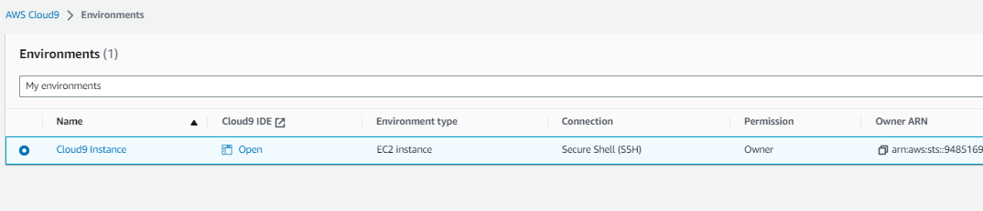
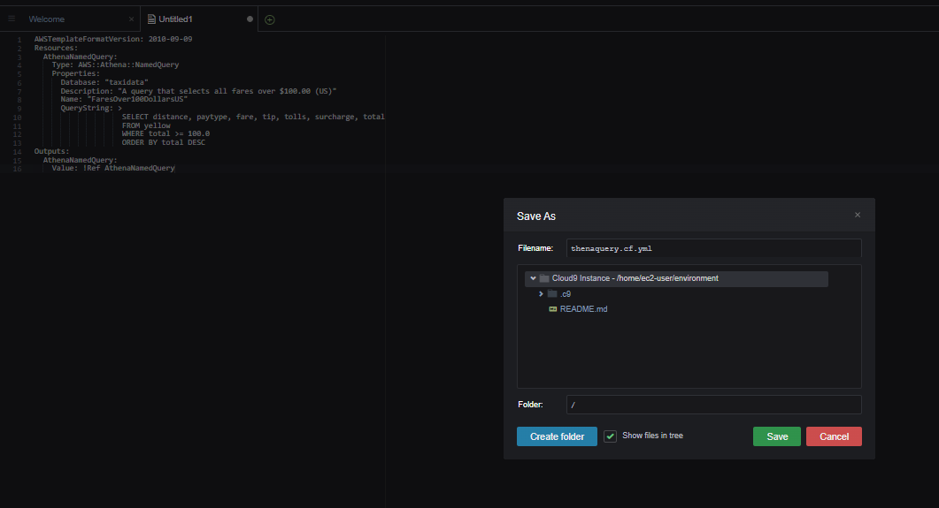
Open the cloud9 IDE
Navigate to the AWS Cloud9 integrated development environment (IDE).
In the AWS Management Console, in the search box next to Services, search for and choose Cloud9 to open the AWS Cloud9 console.
AWS Cloud9 environments are listed.
For the environment named Cloud9 Instance, choose Open IDE.
A new browser tab opens and displays the AWS Cloud9 IDE.
Create a new CloudFormation template.
In the AWS Cloud9 IDE, choose File > New File.
Save the empty file as athenaquery.cf.yml but keep it open.
Copy and paste the following code into the file, and save the file:
AWSTemplateFormatVersion: 2010-09-09
Resources: AthenaNamedQuery: Type: AWS::Athena::NamedQuery Properties: Database: "taxidata" Description: "A query that selects all fares over $100.00 (US)" Name: "FaresOver100DollarsUS" QueryString: > SELECT distance, paytype, fare, tip, tolls, surcharge, total FROM yellow WHERE total >= 100.0 ORDER BY total DESCOutputs: AthenaNamedQuery: Value: !Ref AthenaNamedQuery

Slide 28
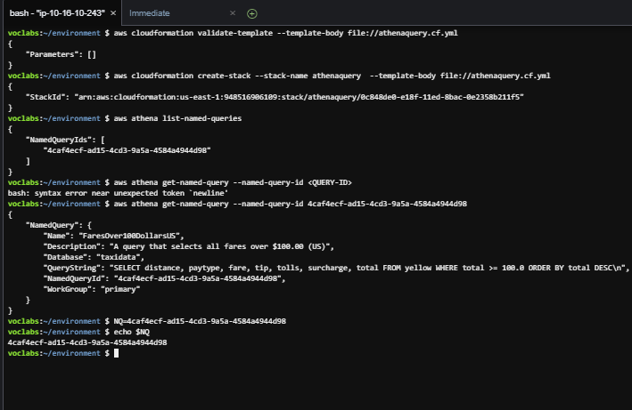
Validate the file and perform the following steps
To validate the CloudFormation template, run the following command in the AWS Cloud9 terminal:
aws cloudformation validate-template --template-body file://athenaquery.cf.yml
To create the stack, run the following command:
aws cloudformation create-stack --stack-name athenaquery --template-body file://athenaquery.cf.yml
Confirm the named query resource that the CloudFormation stack created.
To verify that the named query was created, run the following command in the AWS Cloud9 terminal.
aws athena list-named-queries
Copy the query ID to a text editor.
To retrieve the details of the named query, including the SQL statement that is associated with it, run the following command. Replace <QUERY-ID> with the ID that you saved to a text editor.
aws athena get-named-query --named-query-id <QUERY-ID>
To save the named query ID as a bash variable, run the following command. Replace <QUERY-ID> with the named query ID that you copied earlier. This will make it easier to use the ID in commands in later steps:
NQ=<QUERY-ID>
Confirm the named query id was stored as the bash variable NQ. Run the command below.
echo $NQ

Slide 29
Task 6: Reviewing the IAM policy for Athena and AWS Glue access

Slide 30
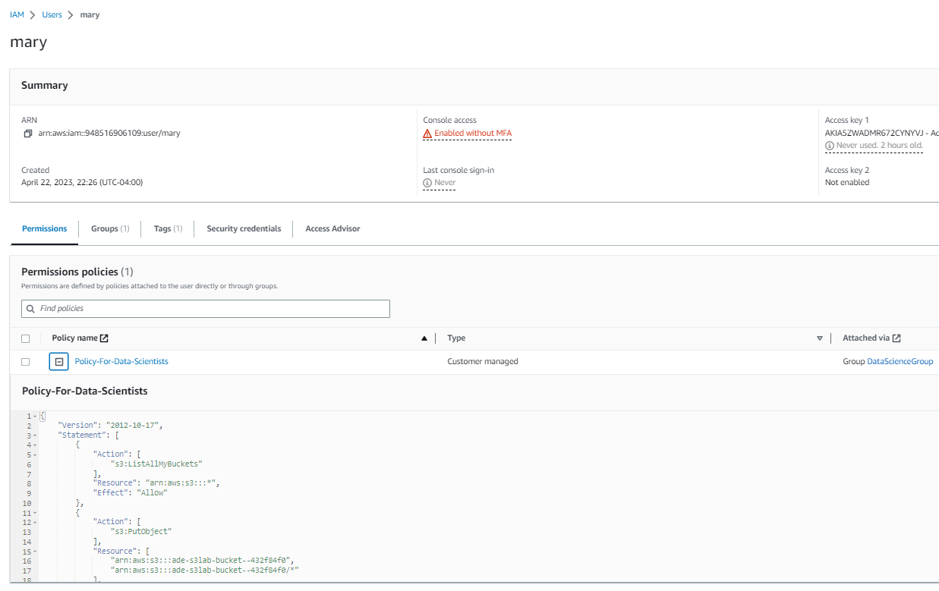
Review the policy in iam
Review the Policy-For-Data-Scientists policy in IAM.
In the search box to the right of Services, search for and choose IAM to open the IAM console.
In the navigation pane, choose Users.
Notice that mary is one of the IAM users that is listed. This user is part of the DataScienceGroup IAM group.
Choose the user name link for mary.
On the Permissions tab, choose the link for the Policy-For-Data-Scientists policy.
The Policy-For-Data-Scientists details page opens. Review the permissions that are associated with this policy. Notice that the permissions provide limited access for only the Athena, CloudFormation, Cloud9, AWS Glue, and Amazon S3 services.

Slide 31
Task 7: Confirming that Mary can access and use the named query

Slide 32
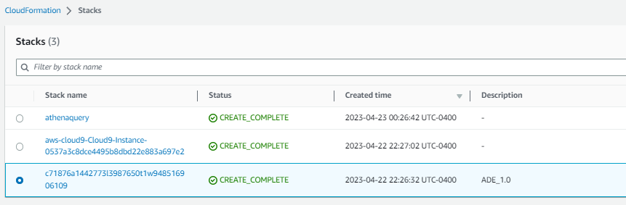
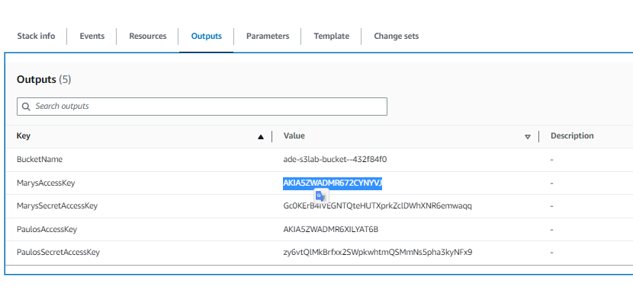

Open cloudformation and choose stacks to check mary’s access
Retrieve the credentials for the mary IAM user.
In the search box next to Services, search for and choose CloudFormation.
In the navigation pane, choose Stacks.
Choose the link for the stack that created the lab environment. The stack name includes a random string of letters and numbers, and the stack should have the oldest creation time.
On the stack details page, choose the Outputs tab.
Note: When you create a CloudFormation template, you can choose to output information about the resources that the template will create. The CloudFormation template that created the resources in your lab environment output the access key and secret access key for the mary user.
Copy the value of MarysAccessKey to your clipboard.
Return to the AWS Cloud9 terminal.
To create a variable for the access key, run the following command. Replace <ACCESS-KEY> with the value from your clipboard.
AK=<ACCESS-KEY>
Return to the CloudFormation console, and copy the value of MarysSecretAccessKey to your clipboard.
Return to the AWS Cloud9 terminal.
To create a variable for the secret access key, run the following command. Replace <SECRET-ACCESS-KEY> with the value from your clipboard.
SAK=<SECRET-ACCESS-KEY>

Slide 33
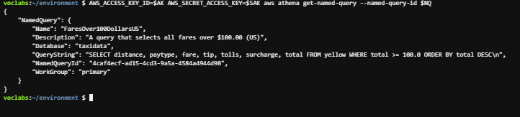
Open cloudformation and choose stacks to check mary’s access
To test whether Mary can use the named query, run the following command:
AWS_ACCESS_KEY_ID=$AK AWS_SECRET_ACCESS_KEY=$SAK aws athena get-named-query --named-query-id $NQ

Slide 34
THANK YOU
Amrit Singh

